Slide 1
IEC61000-4-6 TEST EQUIPMENT SEARCH
This presentation summarizes the following items:
Review of IEC61000-4-6 standard for test (equipment) requirements. The 4th edition is in play (IE 2013).
Review of available (online) literature and application notes regarding test methods and equipment requirements to conduct testing for the IEC61000-4-6 standard.
High level discussion of the advantages/disadvantages of the three test methods specified in the IEC61000-4-6 standard. (CDN, EM Clamp, and BCI).
Flow chart for selecting an appropriate test scenario for CDN, EM Clamp, or BCI test methods.
Search for manufacturers of equipment and accessories designed to be used for IEC61000-4-6 testing.
Summary of quotes received to date. (As of 8/8/2016).
Examples of test configurations for conducting the three tests as specified in the IEC61000-4-6 standard.

Slide 2
EXECUTIVE SUMMARY
Found five manufacturers involved with developing systems and components for IEC61000-4-6 testing.
Request for quotes have been sent out.
We have received some budgetary information. Waiting for more information and lead times.
A used test system with accessories (without a computer) will cost approximately $25,000.(See Appendix 1)
A new generator without accessories and a computer will cost approximately $28,000. (See appendix 3).
A new stand alone 100 Watt RF Amplifier specified for IEC61000-4-6 testing (without accessories and signal generator/spectrum analyzer) will cost $12,245.(See appendix 4).
A system with accessories will cost approximately $2,500 per month to rent. .(See appendix 2).

Slide 3
THE BOTTOM LINE ADVANTAGE TO TESTING TO THE IEC61000-4-6 IN HOUSE
NO NEED FOR AN ANEOCHOIC CHAMBER.
ALL TESTS CAN BE PERFORMED IN HOUSE AGAINST GROUND PLANE (A GROUND PLANE IS IN TACT IN ESD LAB AT FRACKLIN DRIVE, PLEASONTON CALIFORNIA).
TEST CONFIGURATIONS CAN BE ADAPTABLE (“PLUG AND PLAY”).
THE OF COST DOING PREMPTIVE (PRE-SCREEN) TESTS IN HOUSE “OUT WAY” THAT OF DOING SIMILIAR TESTS AT A TEST HOUSE.
NO TRAVEL TIME TO AN OUTSIDE LAB FACILITY .
NO OUTSIDE TEST LAB SET UP COST.

Slide 4
WHAT DOES THE IEC61000-4-6(4th EDITION) IMPACT ?
IEC 61000-4-6:2013: EMC – Part 4-6: Testing and Measurement Techniques – Immunity to Conducted Disturbances, Induced by Radio-Frequency Fields
From the International Electrotechnical Commission webstore:
“IEC 61000-4-6:2013 relates to the conducted immunity requirements of electrical and electronic equipment to electromagnetic disturbances coming from intended radio-frequency (RF) transmitters in the frequency range 150 kHz up to 80 MHz. Equipment not having at least one conducting wire and/or cable (such as mains supply, signal line or earth connection) which can couple the equipment to the disturbing RF fields is excluded from the scope of this publication.”
“The object of this standard is to establish a common reference for evaluating the functional immunity of electrical and electronic equipment when subjected to conducted disturbances induced by RF fields. The test method documented in IEC 61000-4-6:2013 describes a consistent method to assess the immunity of an equipment or system against a defined phenomenon. This fourth edition cancels and replaces the third edition published in 2008 and constitutes a technical revision. It includes the following significant technical changes with respect to the previous edition:
Use of the CDNs.
Calibration of the clamps.
Reorganization of Clause 7 on test setup and injection methods.
Annex A which is now dedicated to EM and decoupling clamps.
Annex G which now addresses the measurement uncertainty of the voltage test level; and informative Annexes H, I and J which are new.”

Slide 5
IEC61000-4-6 TEST LEVELS
No test a required for induced disturbances caused by electromagnetic fields coming from intentional RF transmitters in the frequency range of 9Khz to 150Khz.

Slide 6
IEC61000-4-6 STANDARD REQUIREMENTS FOR TESTING CABLES
EN 61000-4-6 describes three methods of testing in order of preference:
CDN (Coupling-Decoupling Network)
EM-Clamp
3) Bulk Current Injection (BCI)
Guidance Note : While it is recognized that BCI is considered the least repeatable of the test methods, it is also the most flexible in that the current injection clamp can be clamped to cables in difficult orientations and the use of a second clamp (the measurement clamp) allows real-time control of the current injected into the equipment under test.

Slide 7
BASIC EQUIPMENT REQUIRED TO CONDUCT TESTS PER THE IEC61000-4-6 STANDARD
A “ linear” signal source that can sweep from 10KHZ to 300MHZ.(0R HIGHER)
A modulation source that can AM modulate the signal source signal source.(See IEC61000-4-6 standard.)
A broad band RF power amplifier that can provide linear response across a frequency range of 100KHZ to 230MHZ. (0R HIGHER)
The RF amplifier should have sufficient power to test to the IEC6100-4-6 specified test levels given different coupling conditions.
Load matching and attenuators to reduce SWVR and test measurement uncertainty.
Additional signal power and spectrum measuring equipment.(A means to measure delivered power to EUT).
A large ground plane.

Slide 8
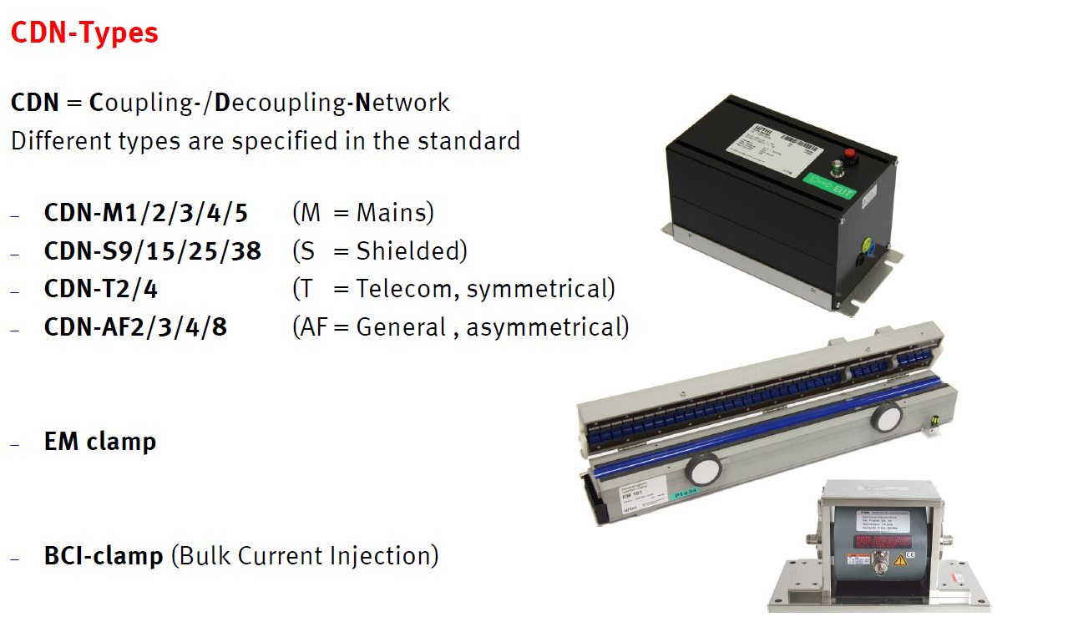
CDN, EM CLAMP, BCI CLAMP TRANSDUCER EXAMPLES USED FOR IEC61000-4-6 TESTING

Slide 9
Place Holder

Slide 10
CDN M3 DIGRAM: (Coupling-Decoupling Network) Test Configuration Concept

Slide 11
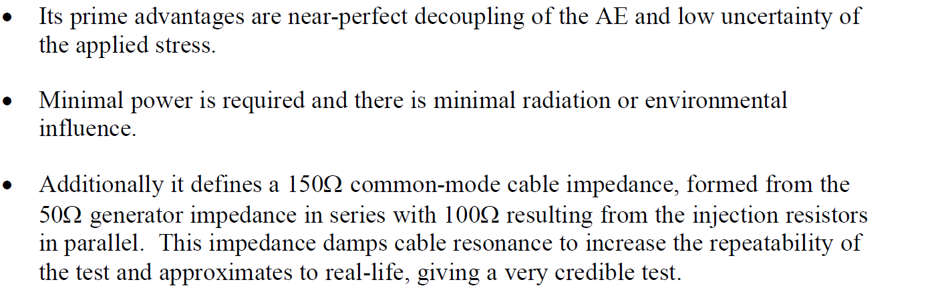
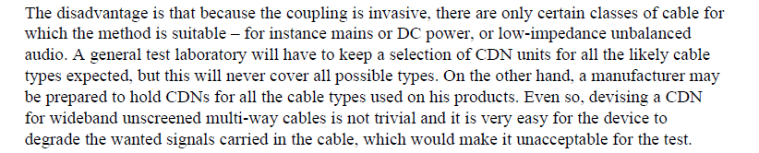
ADVANTAGES/DISADVANTGES OF THE CDN TEST METHOD
Advantages of the CDN Test Method:
Disadvantages of the CDN Test Method:

Slide 12
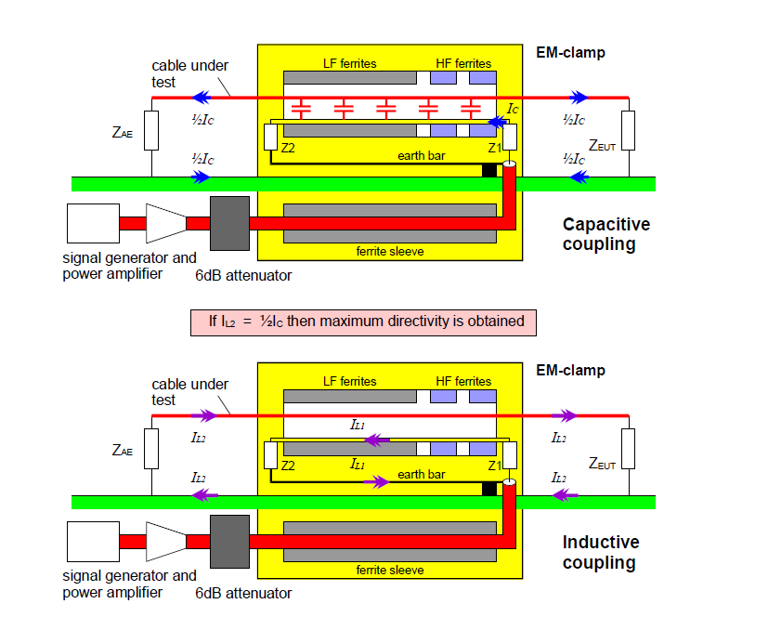
EM CLAMP TEST CONFIGURATION CONCEPT

Slide 13
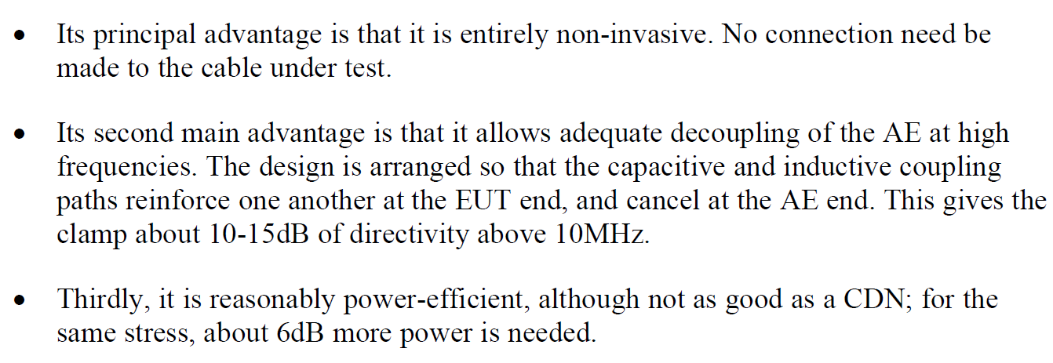
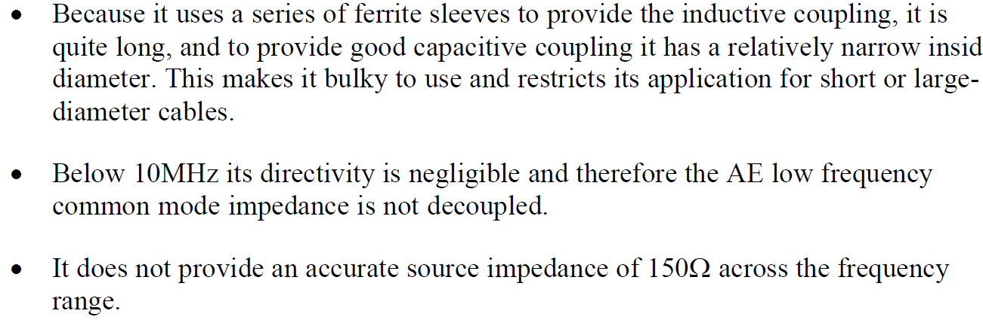
Advantages/Disadvantages of the EM CLAMP Test Method
Advantages of the EM Clamp Test Method:
Disadvantages of the EM Clamp Test Method:

Slide 14
BCI (Bulk Current Injection) Test Configuration Concept

Slide 15
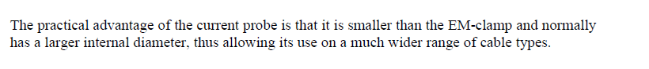
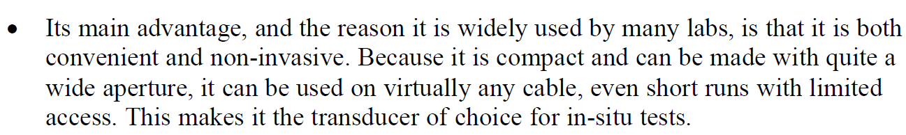
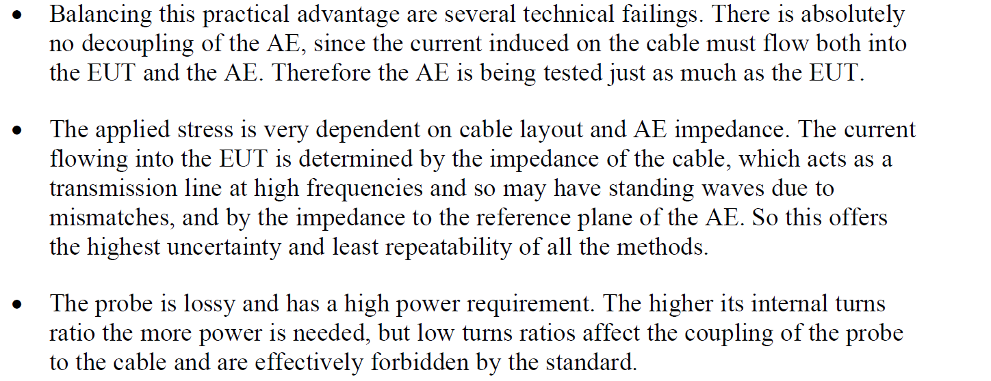
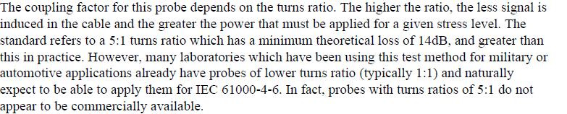
Advantages/Disadvantages of the BCI Test Method
Advantages of the EM Clamp Test Method:
Disadvantages of the EM Clamp Test Method:

Slide 16
PLACE HOLDER

Slide 17
SELECTING AN APPROPRIATE TEST METODOLOGY PER THE IEC61000-4-6 STANDARD

Slide 18
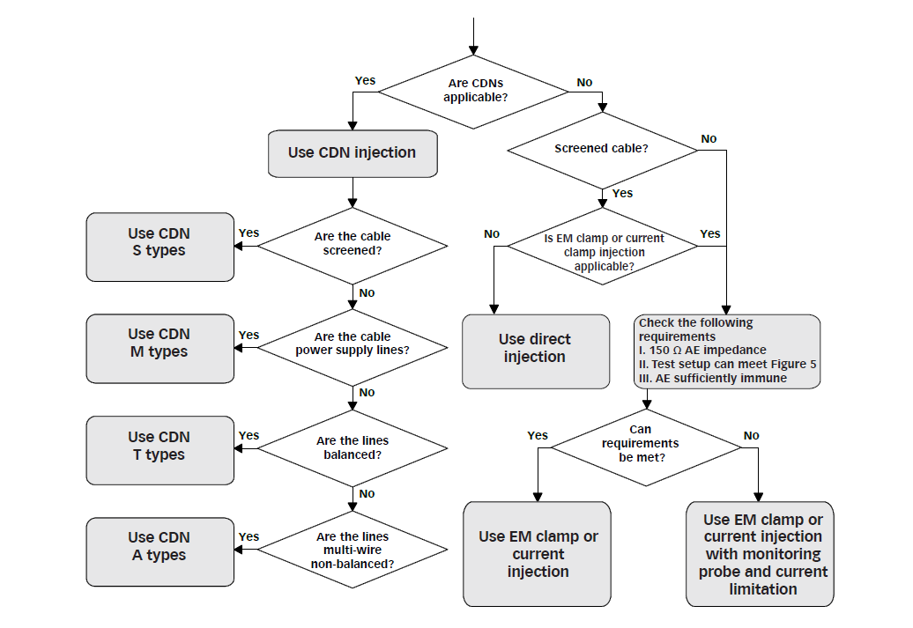
A MORE DETAILED APPROACH TO SELECTING INJECTION METHODS (CDN, EM CLAMP, OR BCI)

Slide 19
CABLE EXAMPLES WITH CDN RECOMMENDATIONS.

Slide 20
COMPARING KEY GENERATOR SPECIFICATIONS.(UNDER DEVELOPMENT)
MANUFACTURER | PART NUMBER | OUTPUT WATTAGE | RF OUTPUT VOLTAGE | AMPLIFIER GAIN | OUTPUT IMPEDANCE | RF AMPLIFER FREQUENCY RANGE | SIGANAL GENERATOR FREQUENCY/POWER MEASUREMENT RANGE | AMPLITUDE MODULATION | 61000-4-6 Ed. 4 TEST LEVELS | SERIAL INTERFACE
Teseq Schaffner | NSG 4070B-80 | 80 W | ? | 50dB | 50 OHMs | 100Khz to 300Mhz | 9kHZ TO 1Ghz | 0 to 100%/1 to 50Khz | LEVEL 1 TO LEVEL 3 | USB
Teseq Schaffner | NSG 4070B-75 | 75 W
EMTEST/AMTEK | EMTE-CWS5001.4 | 80W | 1 TO 30 V( emf) | 48 dB | 50 OHMs | 100Khz to 300Mhz | 9kHZ TO 1Ghz | 1Khz 80% per 61000-4-6/2hz 80% per 60601-1-2/400hz 80% | LEVEL 1 TO LEVEL 3 | USB
AMPLIFIER RESEARCH | CI00250AM1 | 75 W | ? | 49 dB | 50 OHMs | 10Khz to 250Mhz | 9Khz to 1.2Ghz | 1Khz 80% per 61000-4-6/2hz 80% per 60601-1-2/400hz 80% ? | LEVEL 1 TO LEVEL 3 | USB

Slide 21
GENERATOR PRICES FROM QUOTES TO DATE (WAITING FOR ADDITIONAL QUOTES)
MANUFACTURER | GENERATOR PART NUMBER | CONDITION OF EQUIPMENT/SUPPLIER | BASE PRICE
Teseq Schaffner | NSG 4070B-80 (80 WATTS) | NEW FROM: TEST EQUIPMENT CONECTION (SEE NOTE 1) | $27,700
Teseq Schaffner | NSG 4070B-75 (75 WATTS) | USED FROM: ADVANCED TEST EQUIPMENT RENTALS | $21,140
EMTEST/AMTEK | EMTE-CWS5001.4 (75 WATTS) | USED FROM: ADVANCED TEST EQUIPMENT RENTALS(SEE NOTE 2) | $18,750
EMTEST/AMTEK | EMTE-CWS5001.4 | NEW FROM: EMTEST | ?(WAITING FOR QUOTE)
AMPLIFIER RESEARCH | CI00250AM1 (75 WATTS) | NEW FROM: AMPLIFIER RESEARCH | $48,000
AMPLIFIER RESEARCH | CI00400A (100 WATTS) | NEW FROM: AMPLIFIER RESEARCH | $58,000
EMTEST/AMTEK | EMTE-CWS5001.4 | RENTAL FROM: ADVANCED TEST EQUIPMENT RENTALS (SEE NOTE 3) | $1920/MONTH
NOTE 1 : WAITNG FOR QUOTE ON ACCESSORIES. SAINT JUDES MEDICAL HAS AN ACCOUNT WITH “TEST EQUIPMENT CONNECTION”.(I.E. 30 DAYS NET)
NOTE 2 : SEE APPENDIX 1 FOR FULL QUOTE WITH ACCESSORIES.
NOTE 3: SEE APPENDIX 2 FOR FULL QUOTE WITH ACCESSORIES. NOTE 4: SEE APPENDIX 3 FOR QUOTE FOR A STANDALONE RF AMPLIFIER SPPECIFIED FOR IEC61000-4-6

Slide 22
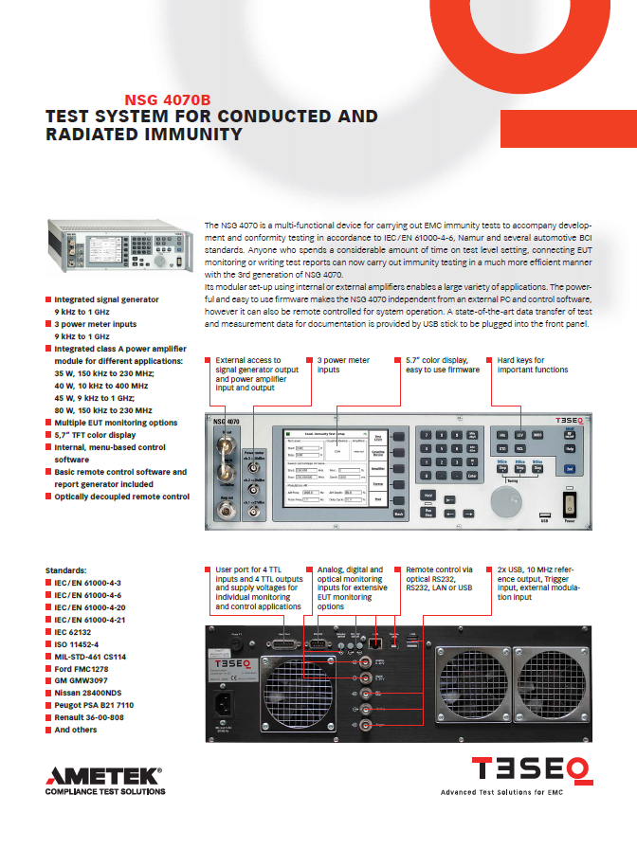
NSG 4070B

Slide 23
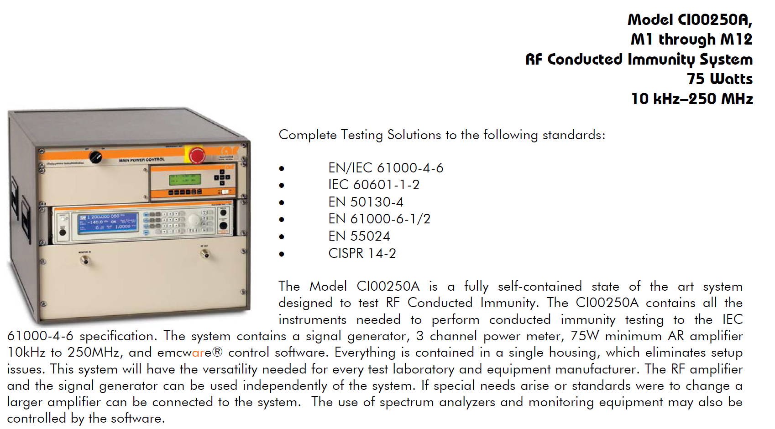
AMPLIFIER RESEARCH MODEL C100250A

Slide 24
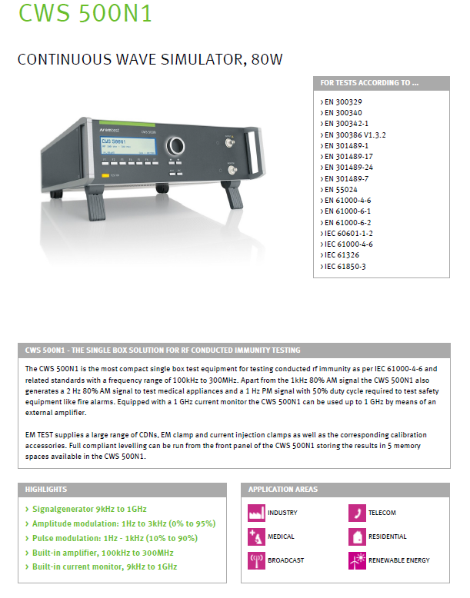
EMTEST/AMTEK MODEL CWS500N1.X

Slide 25
DIAGRAM OF BASIC TEST SETUP WITH A CDN

Slide 26
DIAGRAM OF BASIC TES SETUP WITH AN EM CLAMP WITH CURRENT MONITORING

Slide 27
DIAGRAM OF BASIC TEST SETUP WITH A BCI WITH CURRENT MONITORING

Slide 28
EXAMPLE TEST CONFIGURATIONS

Slide 29
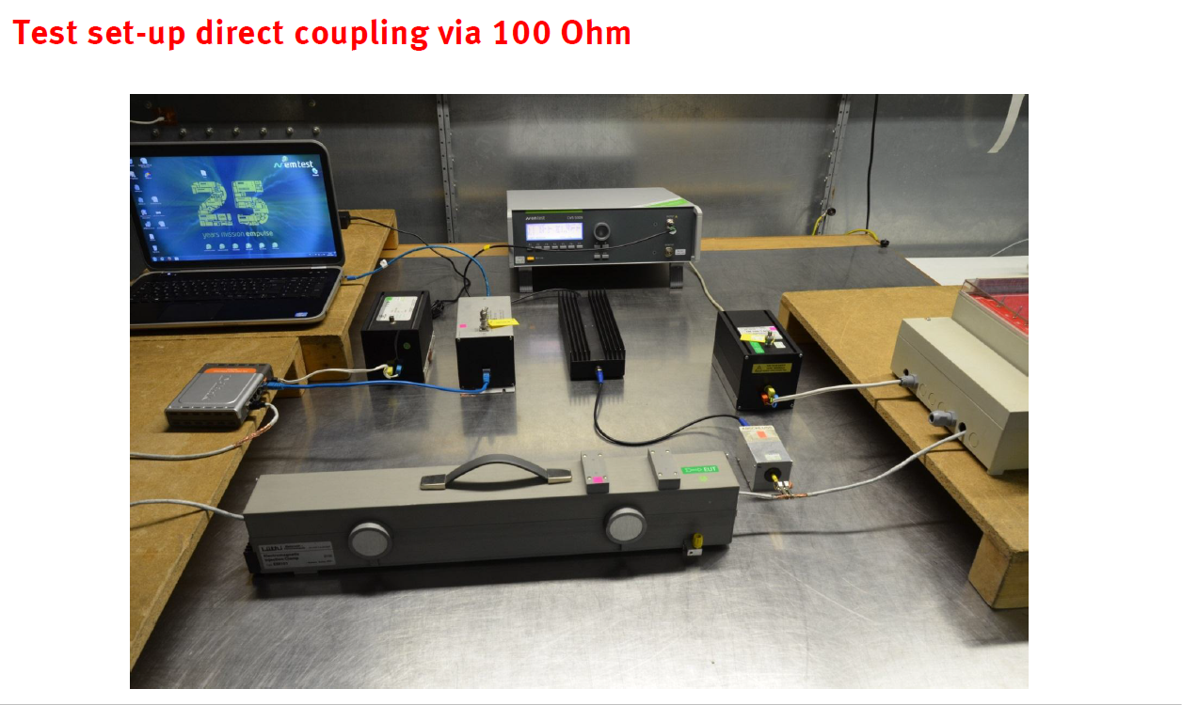

Slide 30
APPENDIX 1 (QUOTE FOR PURSHASE OF EMTE-CWS5001.4 GENERATOR AND ACCESSORIES.)

Slide 31
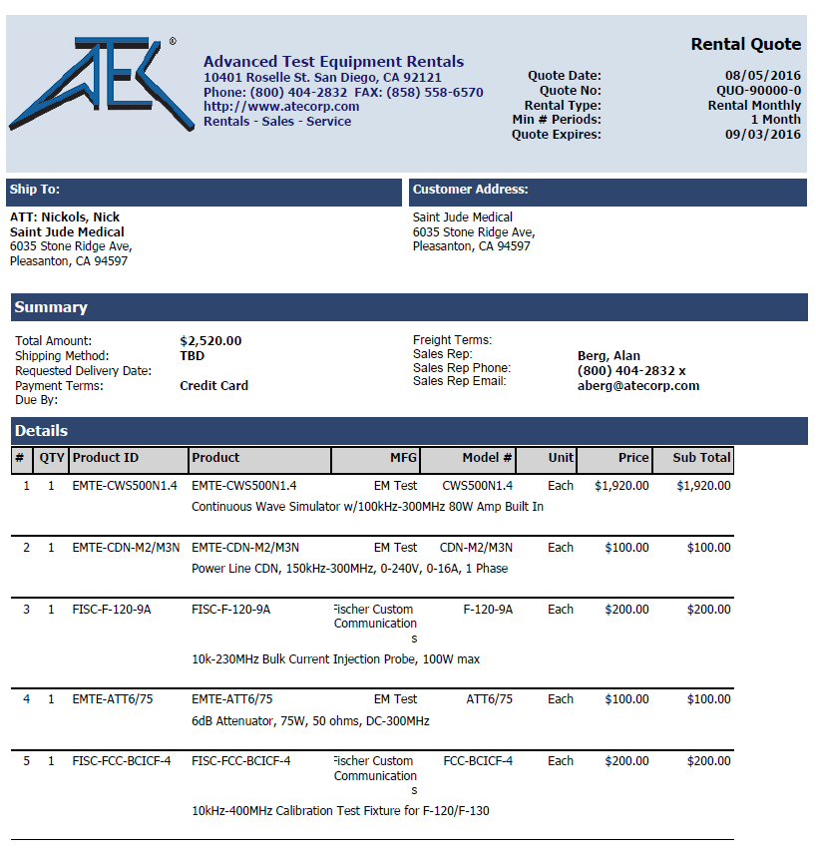
APPENDIX 2 (QUOTE FOR RENT OF EMTE-CWS5001.4 GENERATOR AND ACCESSORIES.)

Slide 32
APPENDIX 3 (QUOTE FOR NSG 4070B-80)

Slide 33
APPENDIX 4 (QUOTE FOR CIS-100 RF AMPLIFIER)

Slide 34
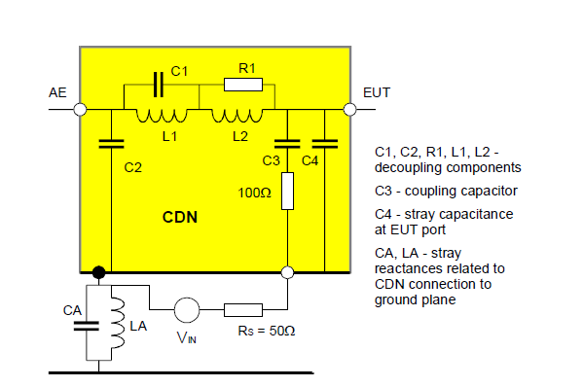
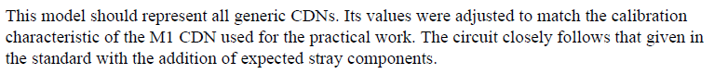
APPENDIX 5: CIRCUIT MODELS FOR CDN

Slide 35
APPENDIX 6: CIRCUIT MODELS FOR EM CLAMP

Slide 36
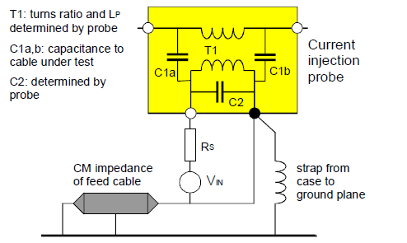
APPENDIX 7: CIRCUIT MODELS FOR CURRENT CLAMP

Slide 37
REFERENCES (Partial List)
Practical Approach to IEC61000-4-6 Testing, Jan Sroka, 2004
EMTEST Transient Immunity Presentation, November 11, 2015
Uncertainties of Immunity Measurements, Tim Williams, 2002
Pitfalls and Practice of IEC61000-4-6 Testing, Tim Williams, 2004
CDN Selection Guide, TESEQ, MAY 2015
IEC 61000-4-6 ed3.0 (2008-10): Electromagnetic compatibility (EMC) - Part 4-6: Testing and measurement techniques - Immunity to conducted disturbances, induced by radio-frequency fields.

